Slide 1
EE 150
Intermediate Programming Concepts for Engineers
Lecture Notes on
Introduction to DICE Package

Slide 2
Software Engineering
Define: what is Engineering?
Define: what is Software Engineering?
Development of the field of Software Engineering
rising complexity
program development process
program life cycle
Why all the fuss – why not just do it?

Slide 3
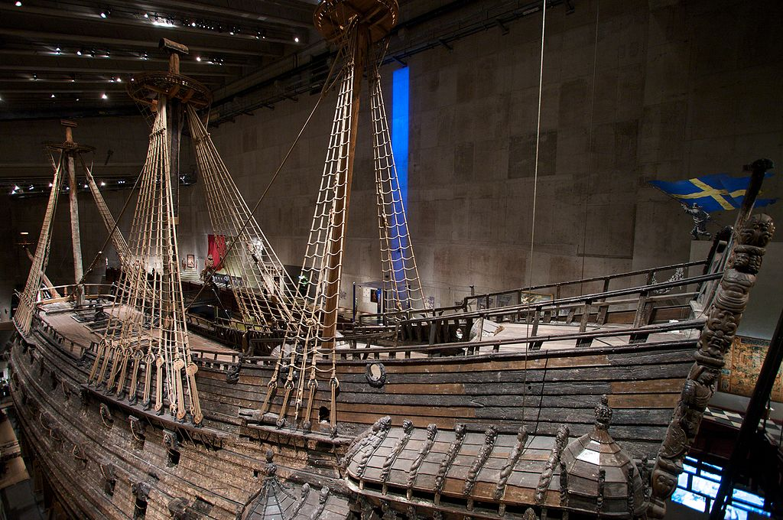
Software Engineering
Case Study: 17th Century Shipbuilding
Vasa (Stockholm) (image: Wikipedia)
Tools and Processes
Processes: Software Engineering
Tools: DICE

Slide 4
DICE and Bash Shell
DICE (the DSPCAD Integrative Command Line Environment) is a software package that we will be using in this course as a standard environment for software development.
http://www.ece.umd.edu/DSPCAD/projects/dice/dice.htm
A shell translates textual lines of commands given by the user into operating system operations that carry out the commands.
The user interacts with the system using a shell.
The Bourne shell and its successor bash (“Bourne Again shell”) are examples of popular shells that originated in UNIX environments. We will be using bash as the standard shell for the course. (not a change – we’ve been using it in EE140)

Slide 5
Scripts
A sequence of operations can be scripted, or automatic, by placing the operations in a script file
A script can be viewed as way to connect groups of programs that may be written in different languages
bash scripts
java scripts
A bash script is a file containing a list of commands to be executed by the bash shell
The DICE environment provides various useful scripts in the form of bash scripts

Slide 6
DICE Startup
Copy a DICE startup file and put it under your ~/ee150 directory. Remember you only need to do this once the whole semester:
mkdir ee150 /* create ee150 directory under your root directory
cd ee150
mkdir startup
cp /DICE/software/common/idice-set-adm/setup/idice_set_startup ~/ee150/startup
Each time when you start a login session, you need to load DICE and startup the standard course environment. From the login shell at your root directory:
source ~/ee150/startup/idice_set_startup

Slide 7
Utility scripts provided in DICE
The dice utilities for directory navigation allow one to label directories with arbitrary (user-defined) identifiers,
… and to move to directories by simply referencing these identifiers (rather than the complete directory path).
This makes it very easy to “jump” from one directory to another.
The main DICE utility related to directory navigation is dlk (the Directory LinKing utility)
Other navigation-related utilities include rlk.

Slide 8
Using the dlk and rlk Utility
Usage: dlk <label>
This assigns a label to a directory.
dlk label names can be of arbitrary length, but should contain only alphanumeric characters (e.g., no spaces).
Once one runs dlk <label>, the user can return to the same directory at any time (during the same login session or a subsequent session) by running the DICE “g” command:
g <label>: cd (change directory) to the directory whose label is <label>.
Usage: rlk <label>
Remove the label associated with a directory

Slide 9
Example on dlk
Example usage:
cd ~/ee150/proj/proj1
dlk p1
cd ~/ee150
g p1
After the above sequence of commands, the user will end up in ~/ee150/proj/proj1 (assuming that this directory exists).

Slide 10
Moving Files Across Directories
dxcu <arg>
move file/directory to DICE user clipboard (temporary directory)
cu stands for "cut"
dxpar <arg>
move file/directory from DICE user clipboard to current working directory
pa-r stands for "paste" and "remove"
dxparl
variations of dxpar, no argument
simply move the last file/directory transferred by dxcu command to current working directory
dxclntmp
clean the DICE user clipboard (temporary directory)

Slide 11
Copying Files Across Directories
dxco <arg>
copy file/directory to DICE user clipboard (temporary directory)
co stands for "copy"
dxpa <arg>
copy file/directory from DICE user clipboard to current working directory
pa stands for "paste"
dxpal
variations of dxpa, no argument
simply copy the last file/directory transferred by dxcu command to current working directory

Slide 12
Example
Suppose proj1 and proj2 are project directories that have been previously labeled as pr1 and pr2, respectively, by dlk
Suppose there is a file called utilities.c in the proj1 directory
This can file be copied to the proj2 directory with the following steps: g pr1 dxco utilities.c g pr2 dxpal

Slide 13
DICE Utilities for Archiving Directories
dxpack: archives a directory (recursively including all sub-directories) as a gzipped tar file (.tar.gz).
Usage: dxpack <directory_name>
The directory name can be followed by an optional "/"
Example usage: dxpack project
Example usage: dxpack my_files/

Slide 14
DICE Utilities for Extracting Directories
dxunpack: Extract the contents of a tar.gz archive
Usage: dxunpack <archive_name>
The trailing .tar.gz in the <archive_name> can be omitted or included --- it works either way.
Example usage: dxunpack project2 (extracts from project2.tar.gz)
Example usage: dxunpack my_files.tar.gz (extracts from my_files.tar.gz)
Note: The archive (.tar.gz file) is removed as a side effect of dxunpack utility

Slide 15
idx Utilities
A set of utilities is provided as a companion to DICE for convenient interaction with the course environment.
These include:
idxget <file>: to get a distributed file (e.g., a C file example) for the course
idxupdate <directory>: to get a distributed directory (e.g., a project example or template) for the course.
idxlist <no arguments>: to list the current set of distributed files and directories along with their associated modification dates
Note that idxget and idxupdate overwrite any previous version of the file/directory in your current working directory.
Distributed directories are generally distributed as .tar.gz archives. You can use idxget to get the archive file or you can use idxupdate for an.tar.gz archive to get a distributed directory (already unpacked).

Slide 16
Get a distributed file/directory
You can first use idxlist to check available files and directories
idxget vimrc-mine.txt /*get file vimrc-mine.txt */
/*get tar.gz file */
idxget inner-product-program-example.tar.gz
/*get a zipped directory and unzip it*/
idxupdate inner-product-program-example.tar.gz
ee150(1037): idxlist
Aug 27 23:59 inner-product-examples.tar.gz
Aug 26 16:06 vimrc-mine.txt
Aug 26 16:06 submit
Aug 24 16:12 README.txt

Slide 17
User-defined bash startup customizations (optional)
User-defined bash customizations should be placed in ~/ee150/customizations
Any bash customizations placed in this file will automatically be linked in by the course environment
Such customization files follow the syntax of bash scripts
Lines that start with ‘#’ are comment lines
The first line should look like this: #!/bin/bash
This specifies which shell to use to process the customizations
Popular forms of customizations include functions and aliases

Slide 18
Bash customization example
#!/bin/bash
# Listing files
function l /* the function name is small “L” (not “one”) */
{
ls -a -F $@
}
# Listing files in long format.
function ll /* the function name has two small “L”s */
{
ls -l $@
}
# Change directory to one or more levels above (alias examples).
# Aliases are generally simpler and less powerful compared to functions.
alias gp="cd .."

